Slide 1


Online Bus Ticket Booking
Submitted by:-
Harshad Kumhar [229]
GUIDE BY:-
Prof.Swati Khandelwal

Slide 2
INDEX
1.Introduction of Proposed System
2.Scope of proposed System
3.Objective Of Proposed System
4.Task Dependency Diagram
5.DFD
6.Client Side
7.Admin Side

Slide 3
Introduction of Proposed System
Easy Ride is a user-friendly, efficient, and scalable online ticket booking system designed to simplify the process of booking bus tickets. Our system aims to provide a seamless experience for passengers, while also streamlining operations for bus operators
User-Friendly Interface
Time-Saving
Real-Time Updates
Secure Payment Gateway
Seat Selection
Increased Sales
.Customer Support

Slide 4
Scope of Proposed System
Online Booking
Seat Selection
Payment Gateway
Schedule Management
Ticket Confirmation
Cancellation and Refund
User Accounts
Reporting and Analytics
Integration with Operators
Customer Support

Slide 5
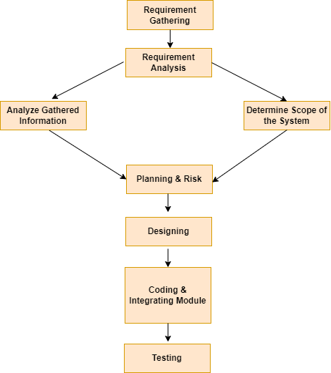
Task Dependency Diagram

Slide 6
DFD / UML
DFD :- DATA FLOW DIAGRAM

Slide 7
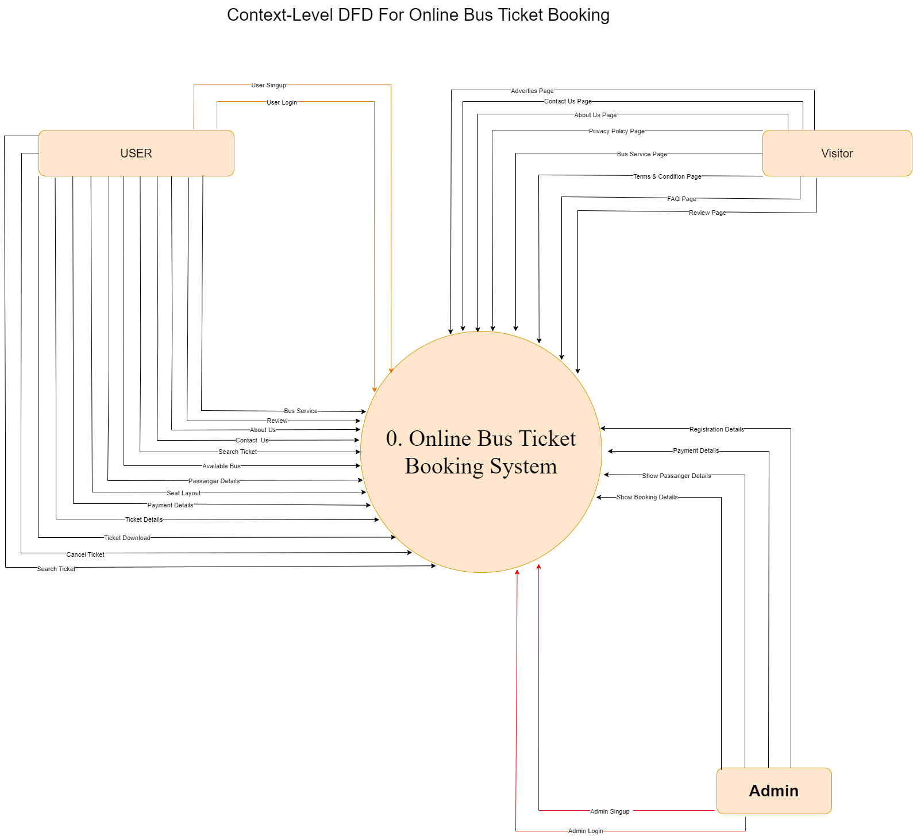
User/Admin Side 0 Level DFD

Slide 8
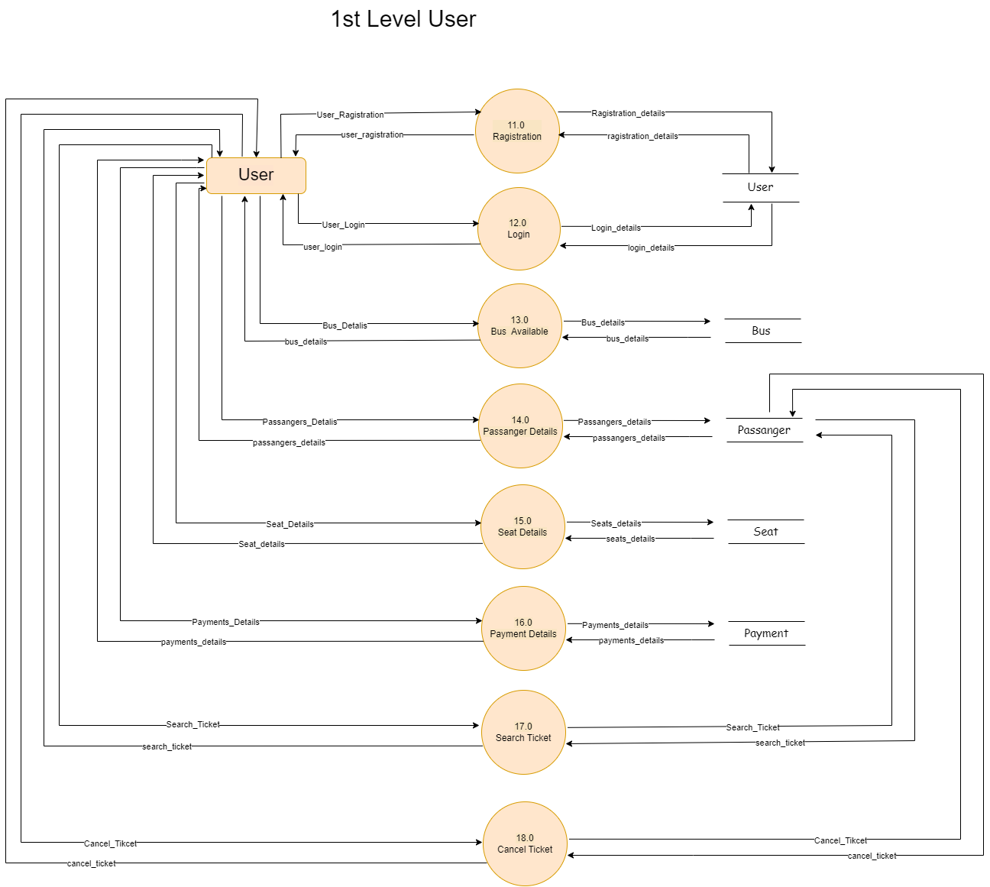
User Side 1 Level DFD

Slide 9
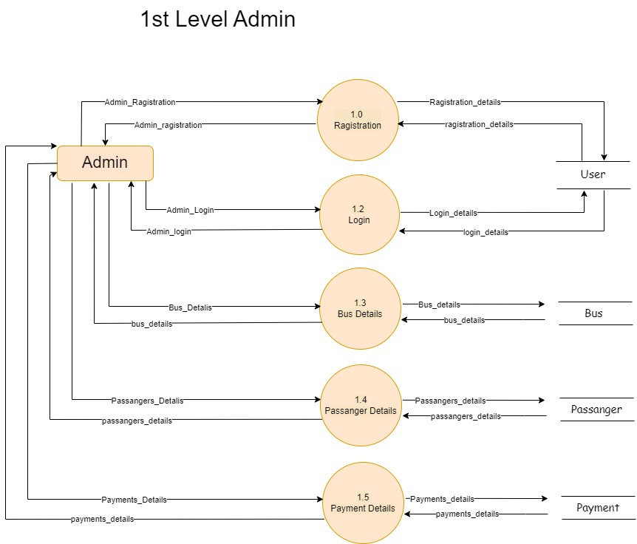
Admin Side 1 Level DFD

Slide 10
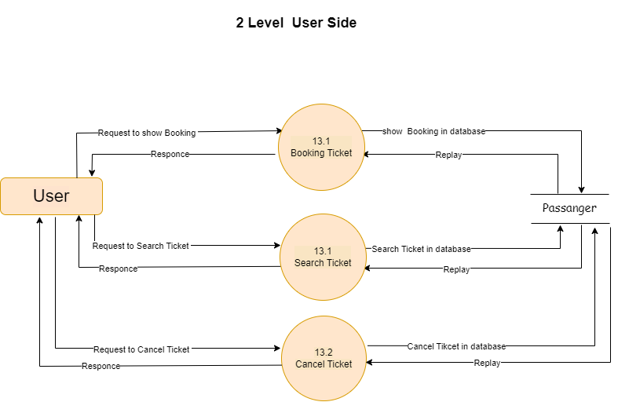
User Side 2 Level

Slide 11
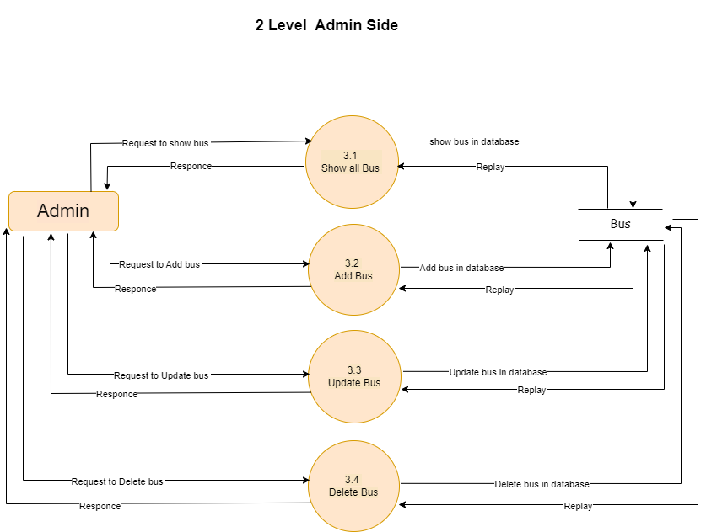
Admin Side 2 Level DFD

Slide 12
USER SIDE INTERFACE

Slide 13
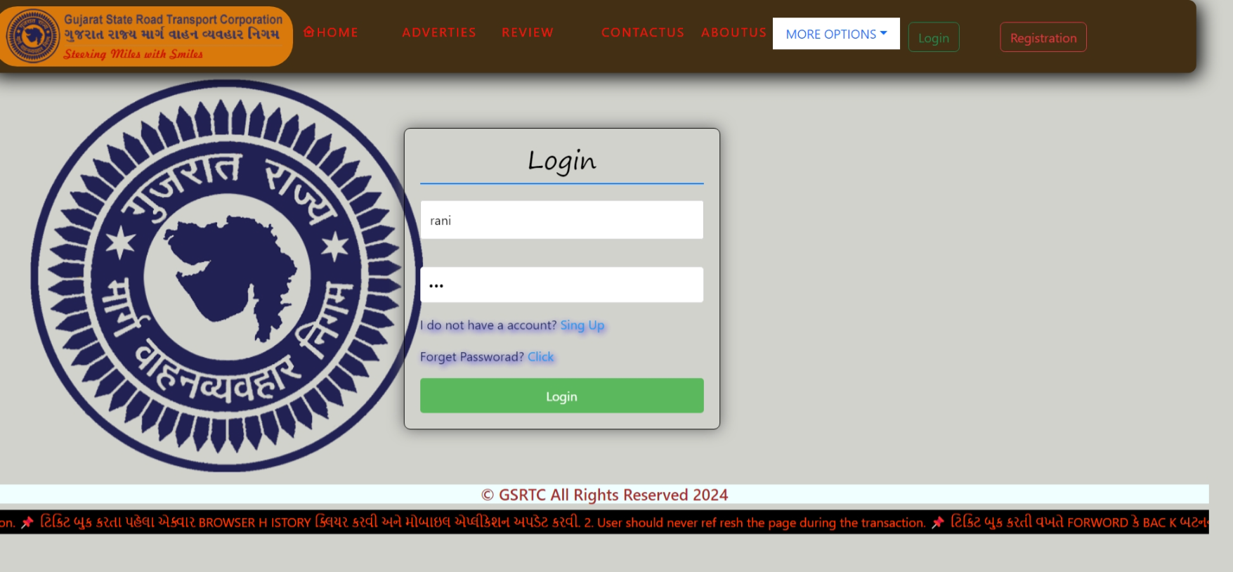
LOGIN PAGE

Slide 14
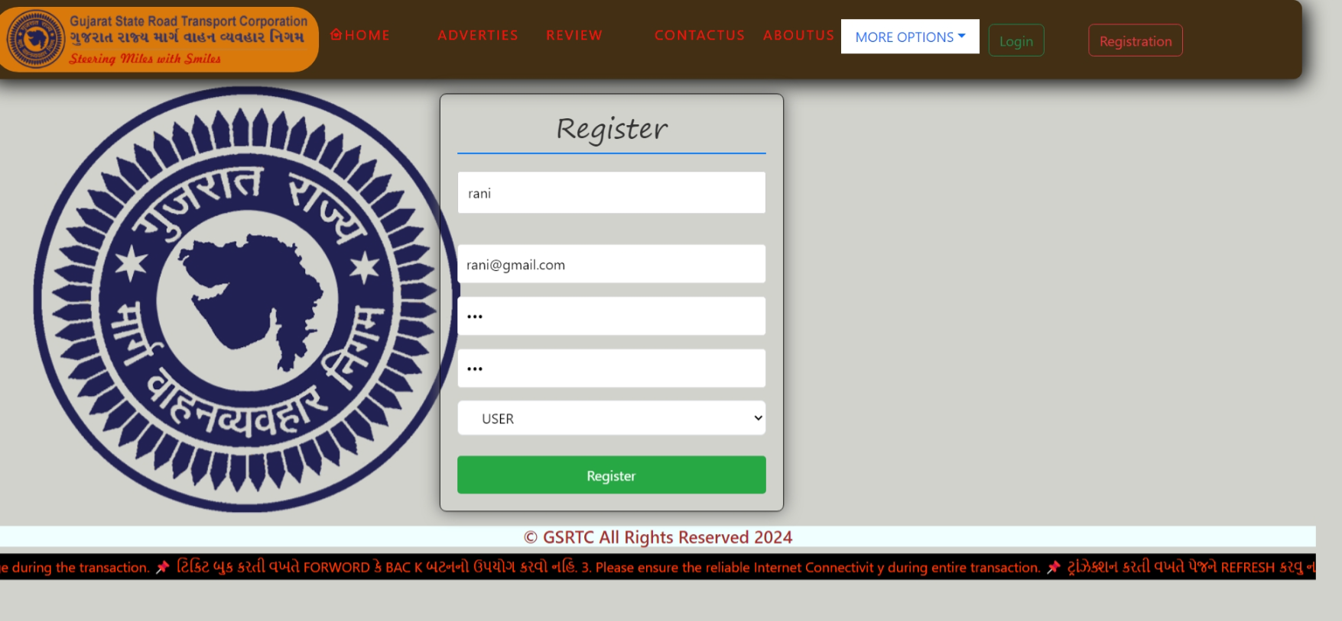
REGISTRATION PAGE

Slide 15
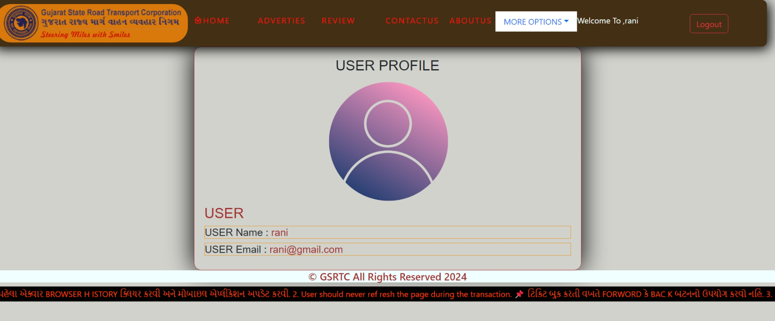
USER PROFILE PAGE

Slide 16
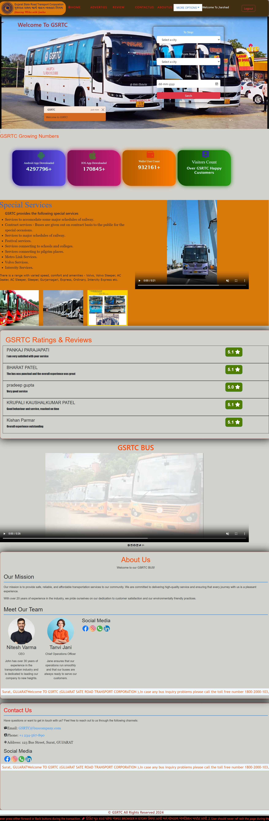
HOME PAGE

Slide 17
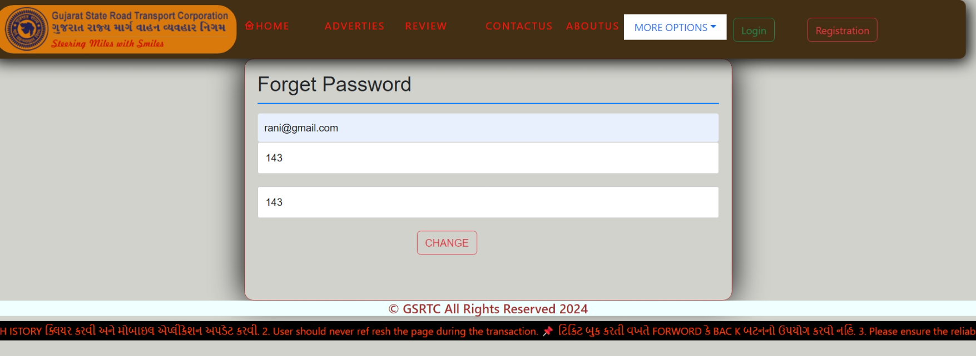
FORGET PASSWORD PAGE

Slide 18
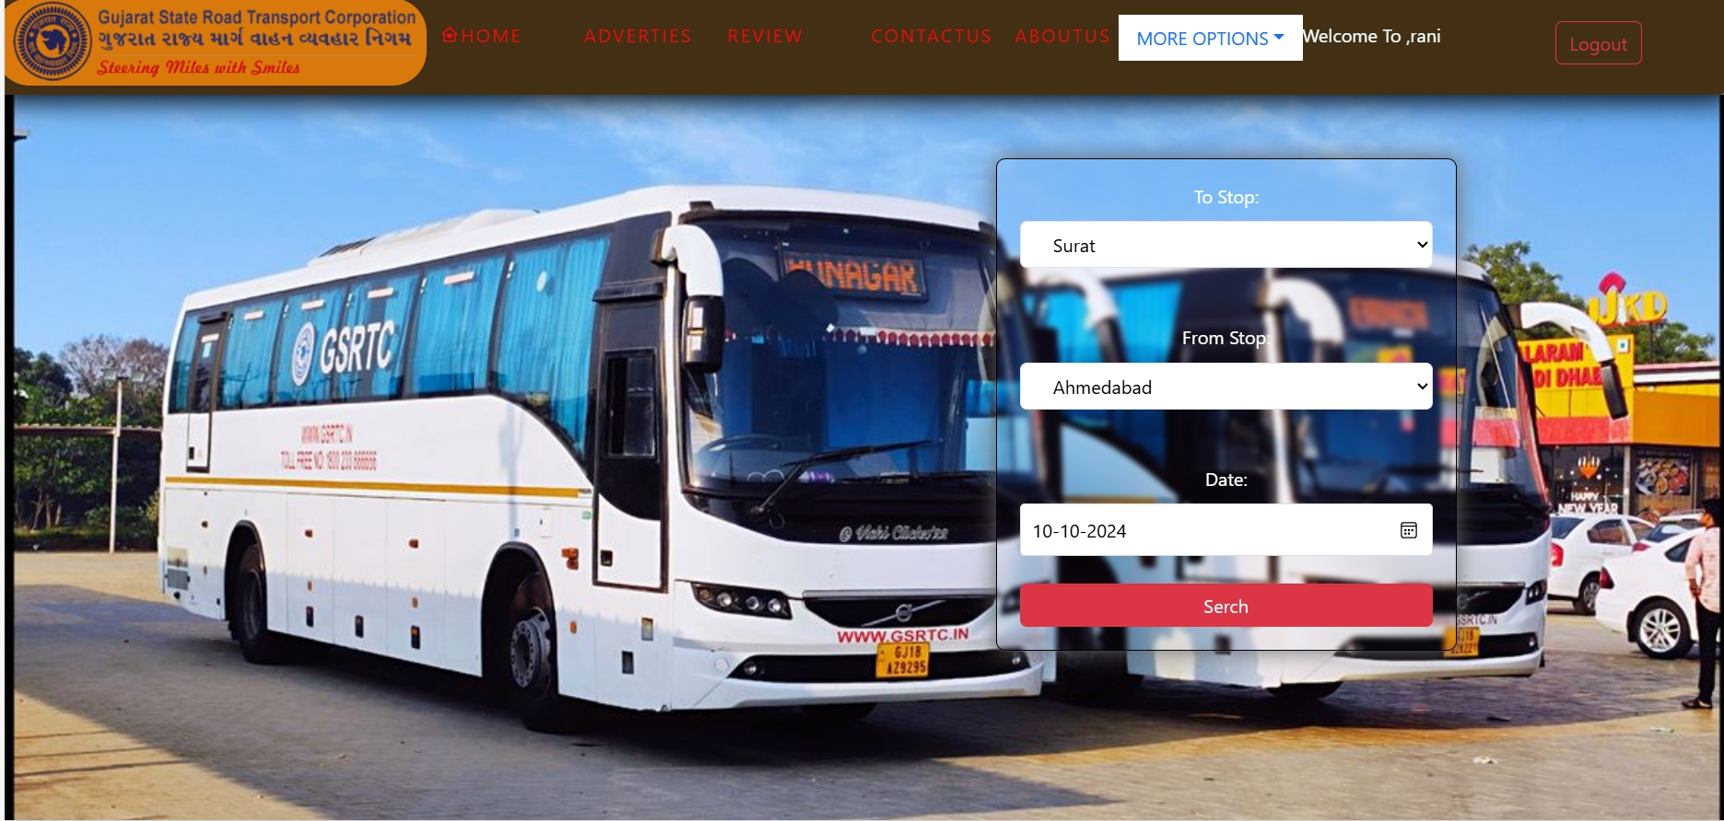
Search Tikcet Page

Slide 19
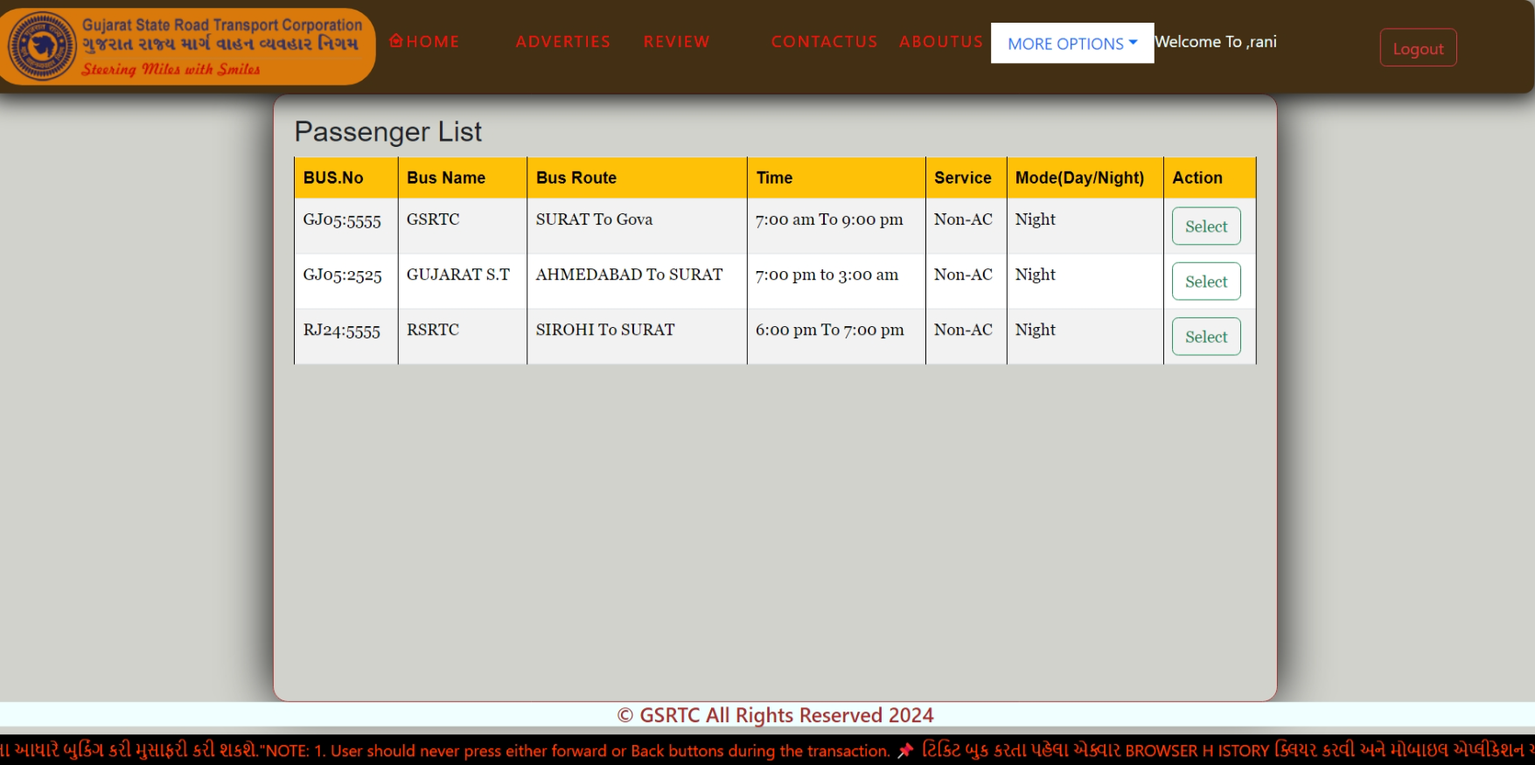
AVAILABLE BUS PAGE

Slide 20
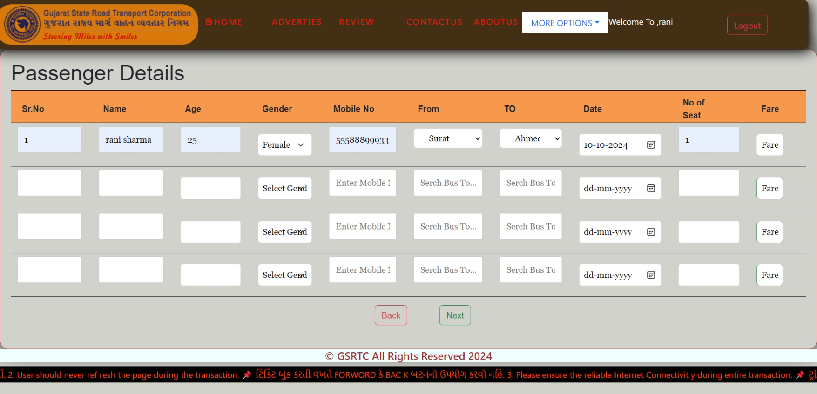
PASSANGER DETAILS PAGE

Slide 21
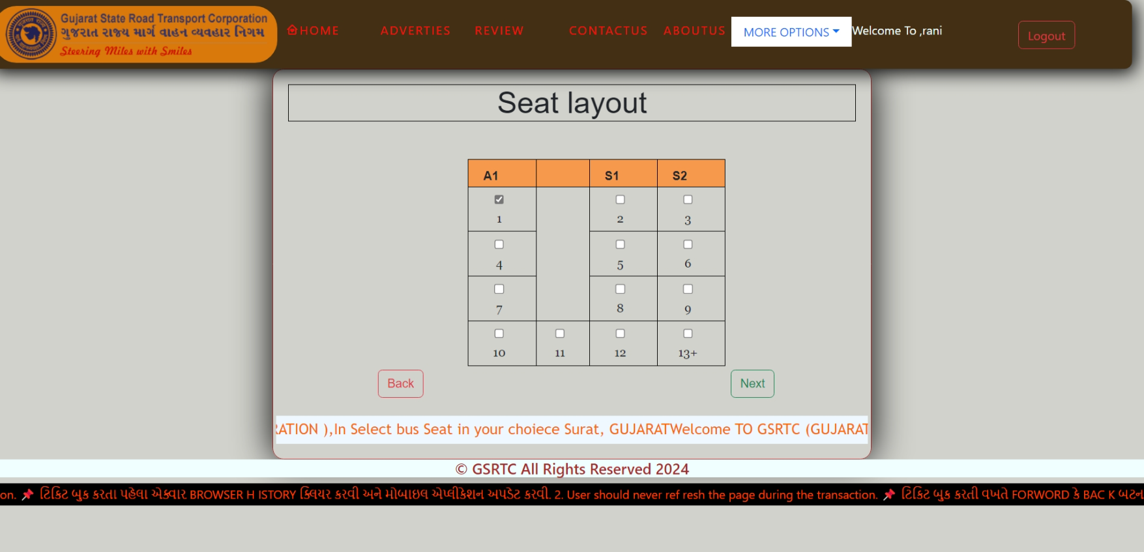
SEAT LAYOUT PAGE

Slide 22
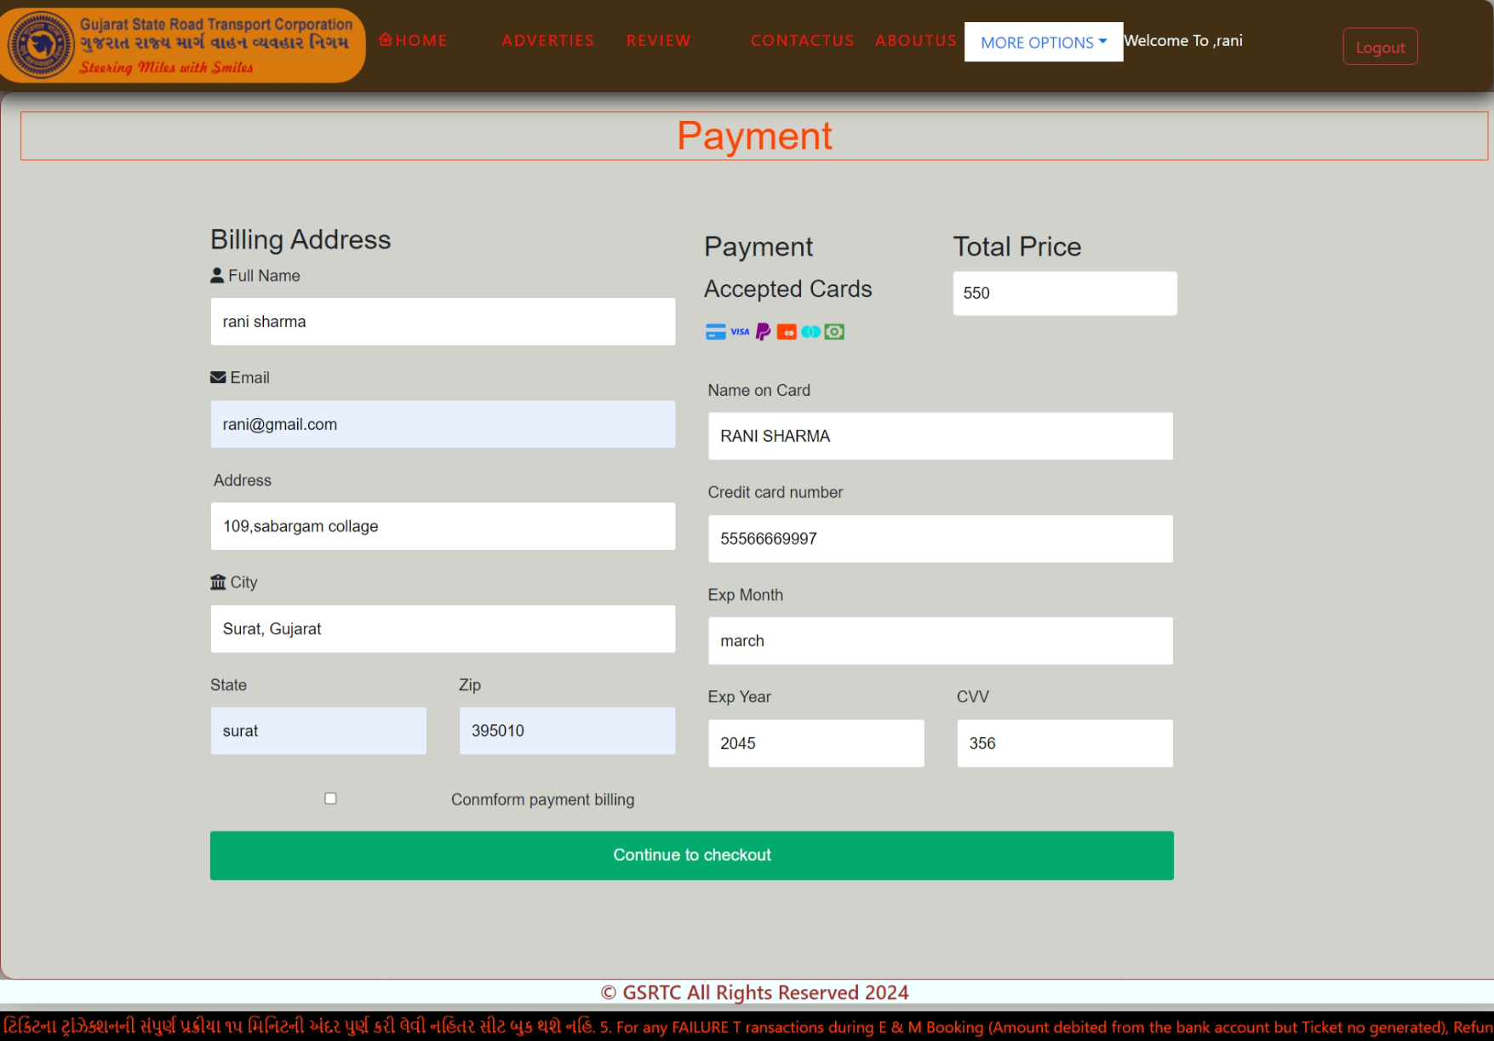
PAYMENT PAGE

Slide 23
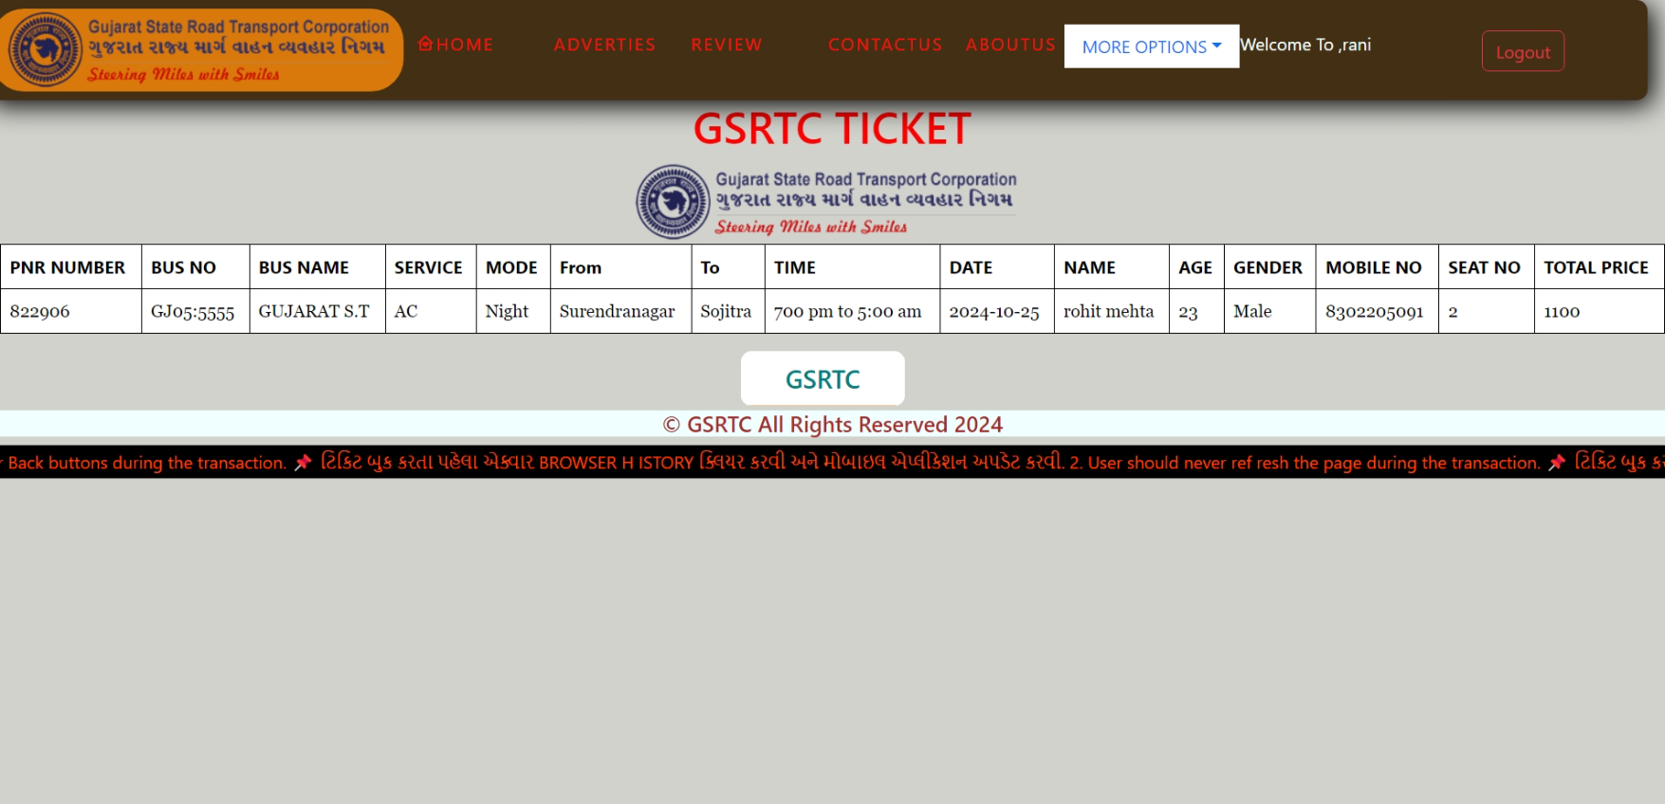
TICKET LAYOUT PAGE

Slide 24
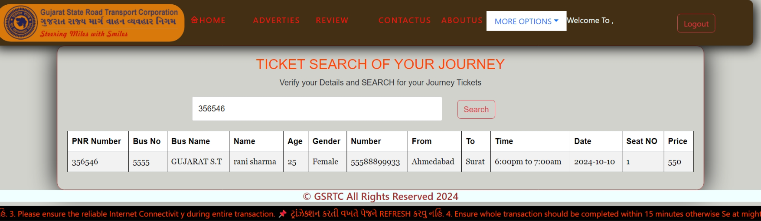
SEARCH TICKET PAGE

Slide 25
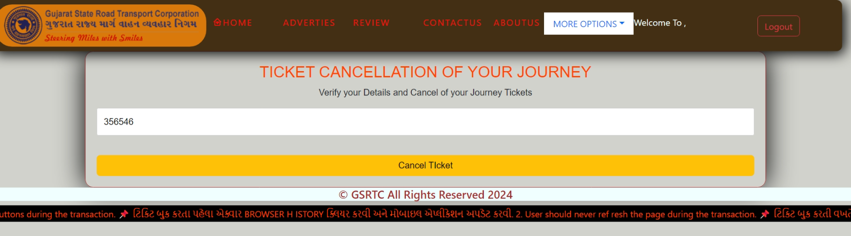
CANCEL TICKET PAGE

Slide 26
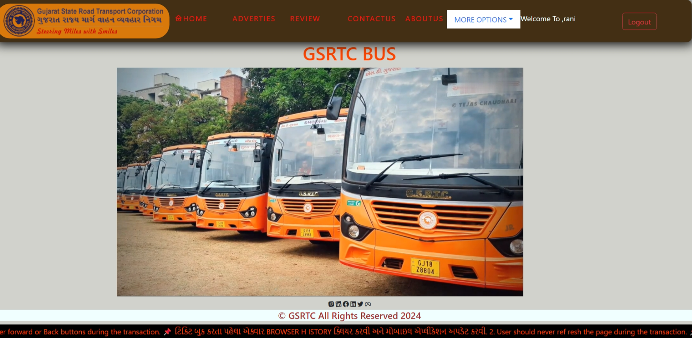
ADVERTIES PAGE

Slide 27
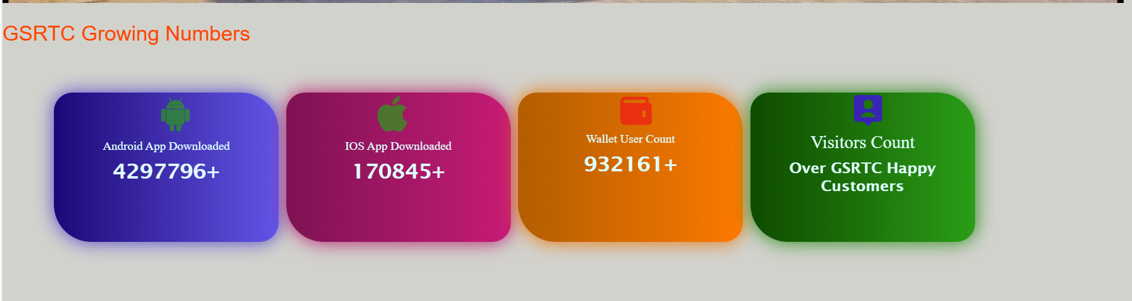
NUMBER GROWING PAGE

Slide 28
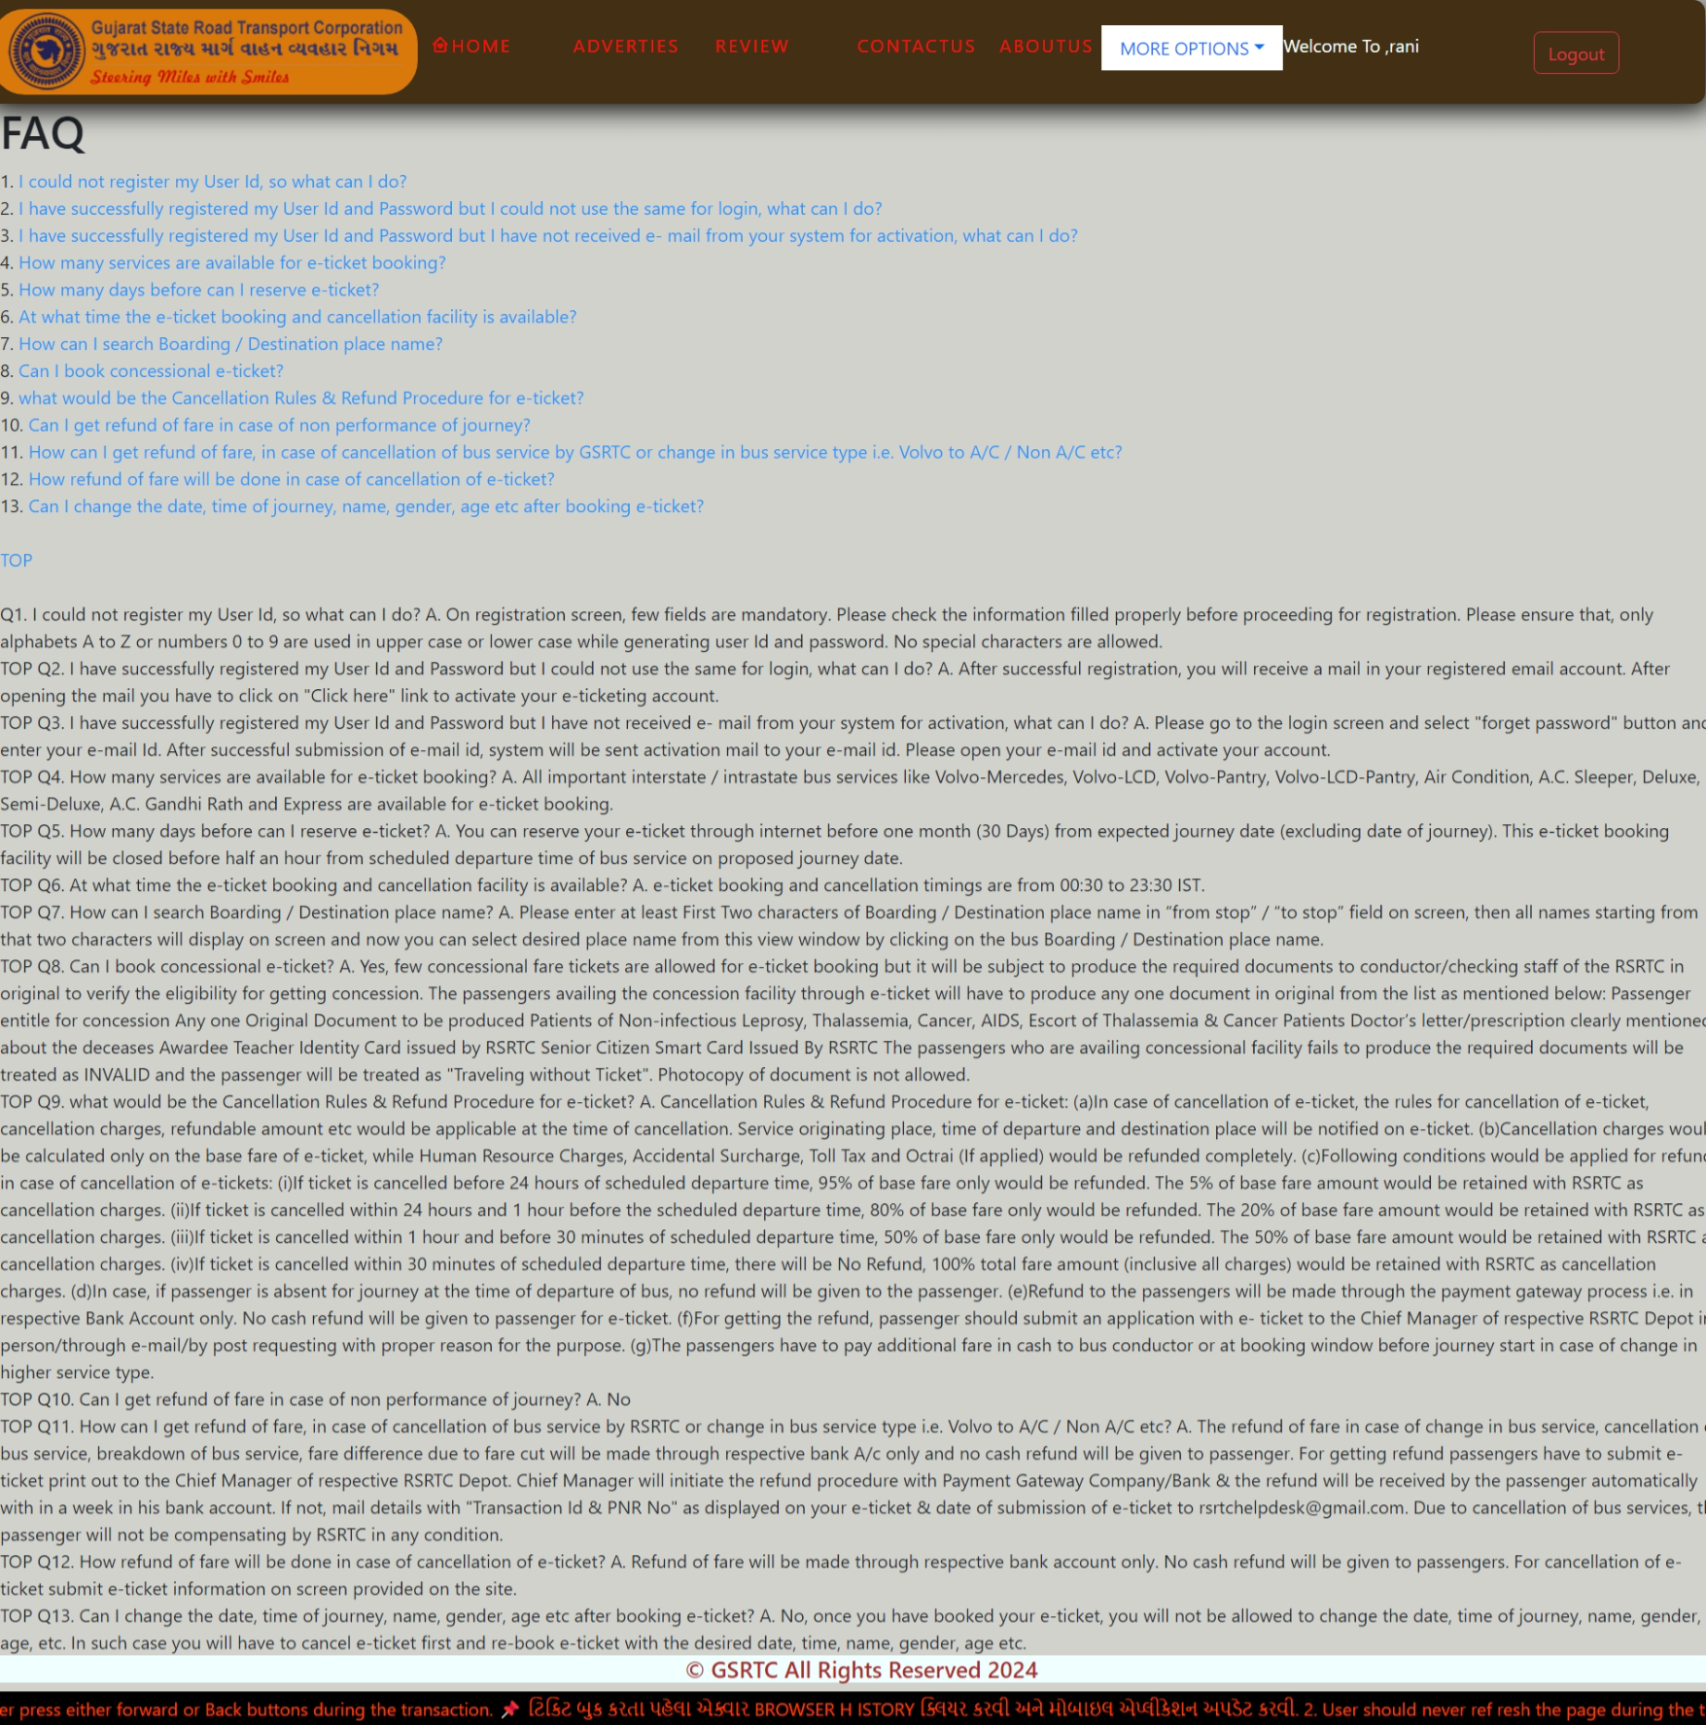
FAQ PAGE

Slide 29
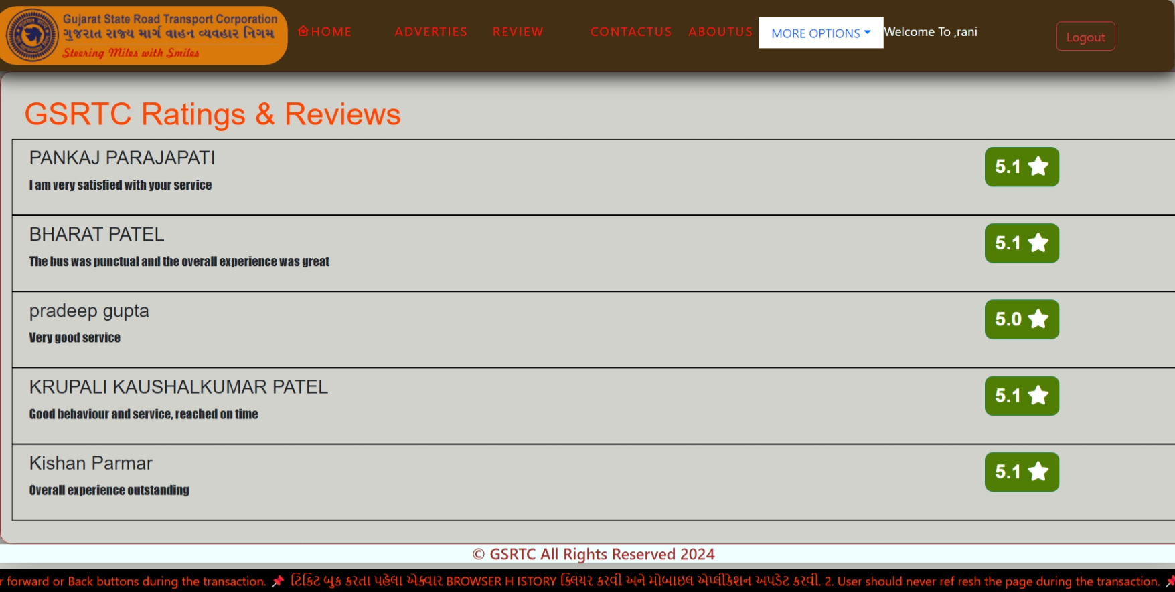
REVIEW PAGE

Slide 30
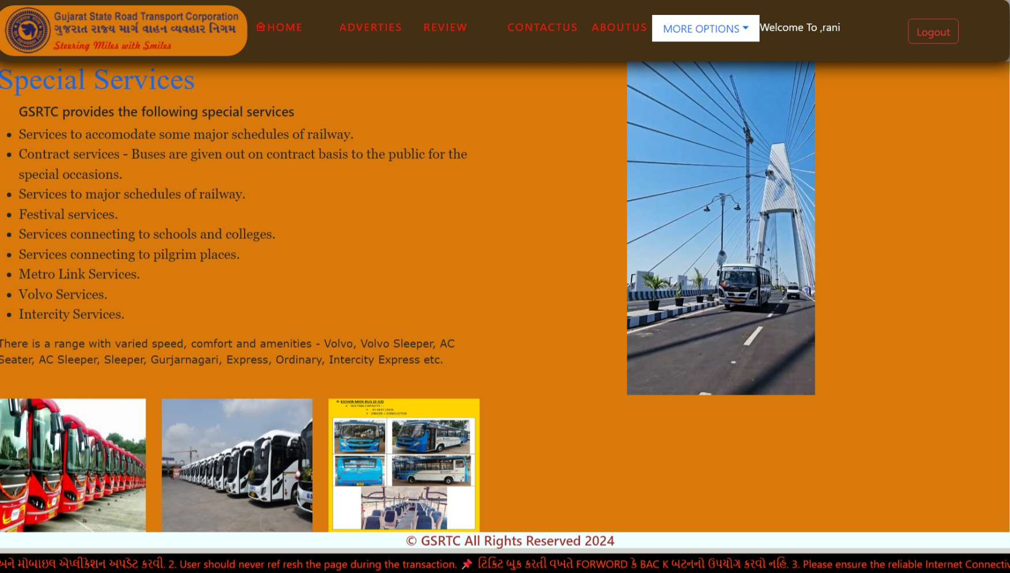
SERVICE PAGE

Slide 31
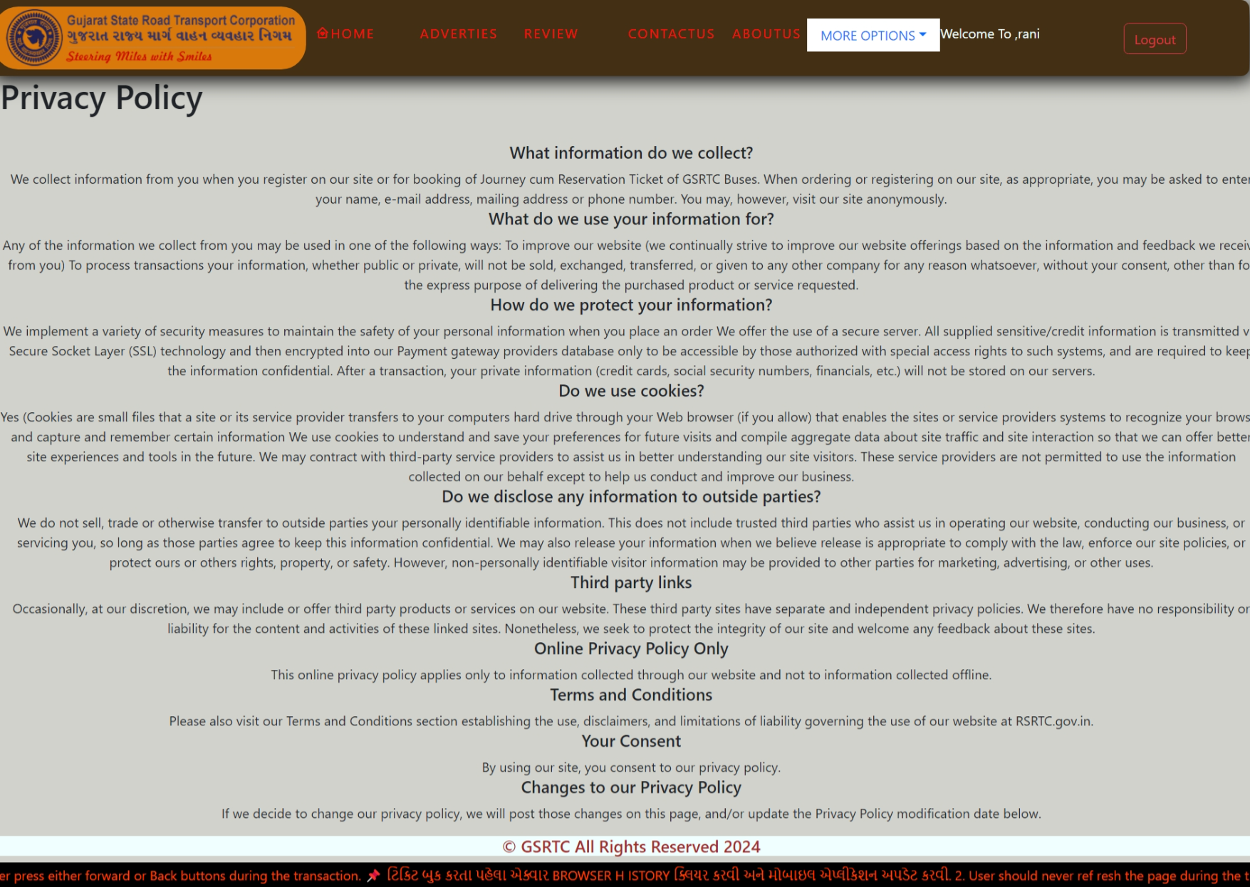
PRIVACY & POLICY PAGE

Slide 32
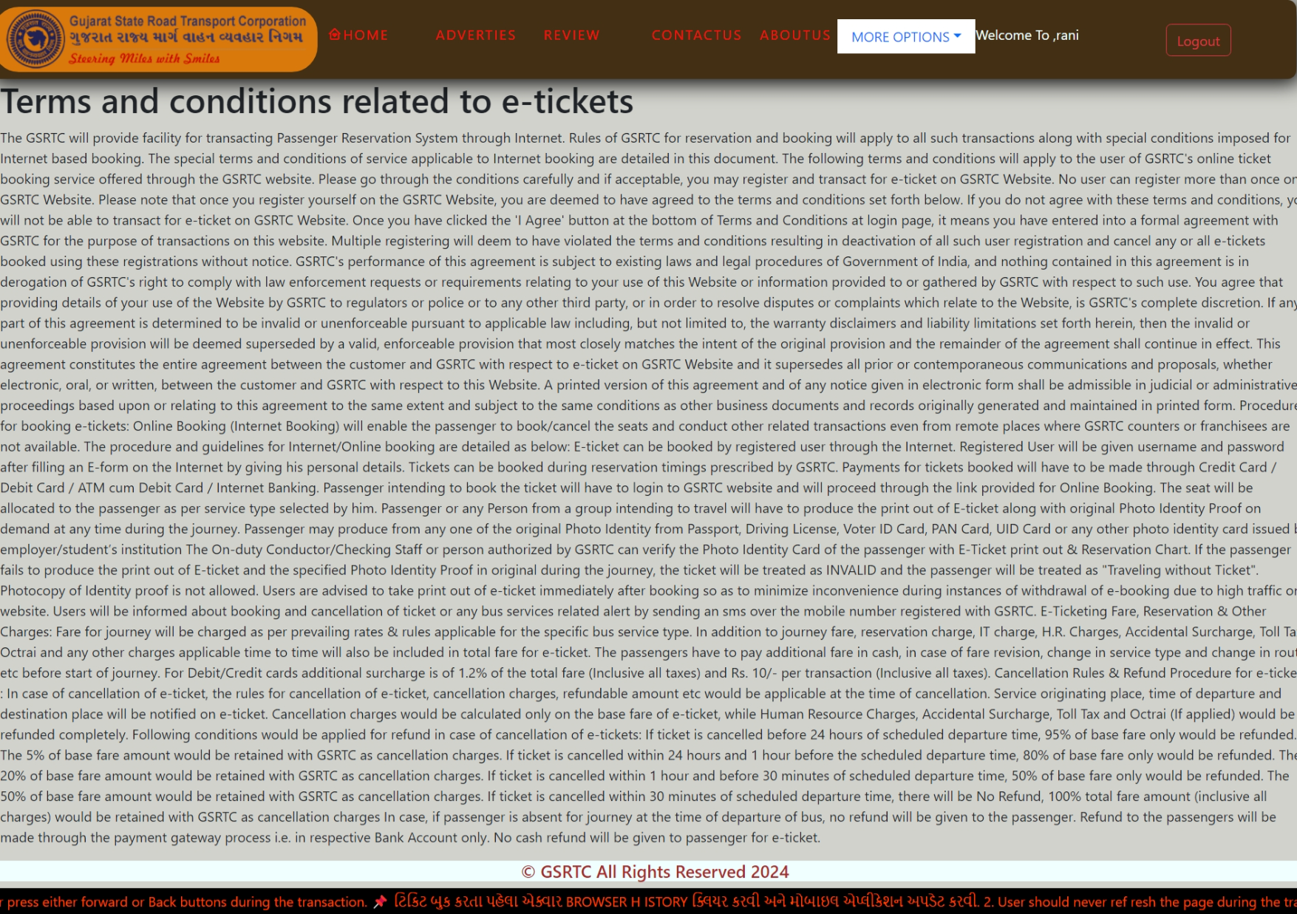
TERMS & CONDITIONS PAGE

Slide 33
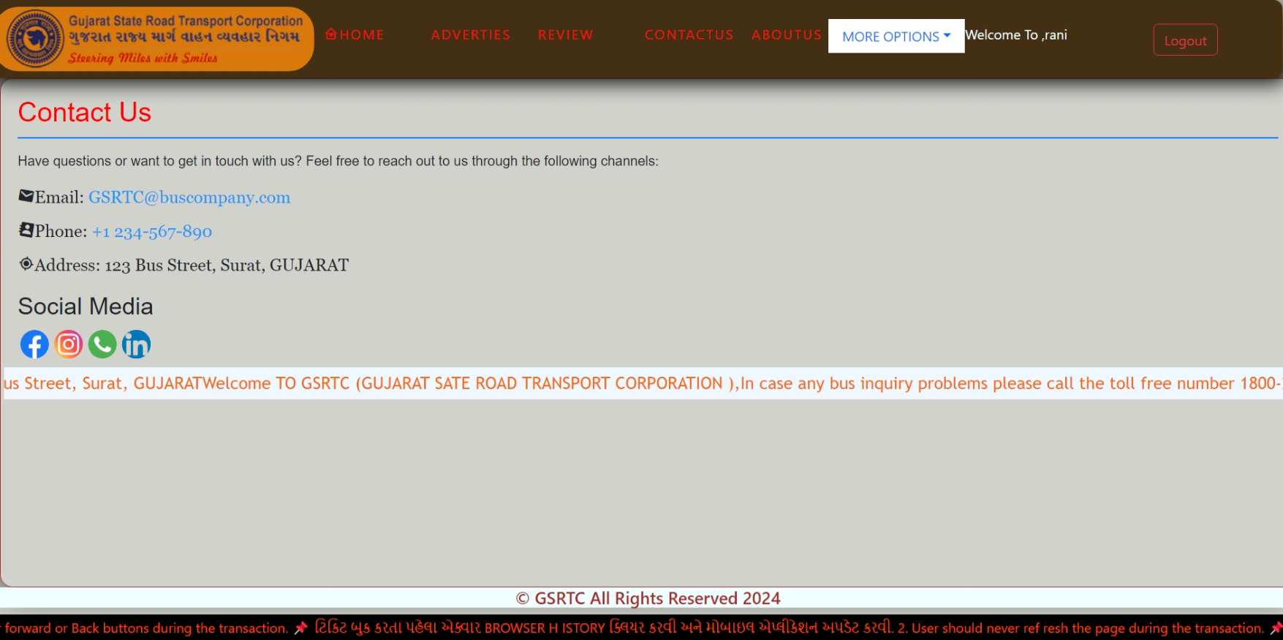
CONTACT US PAGE

Slide 34
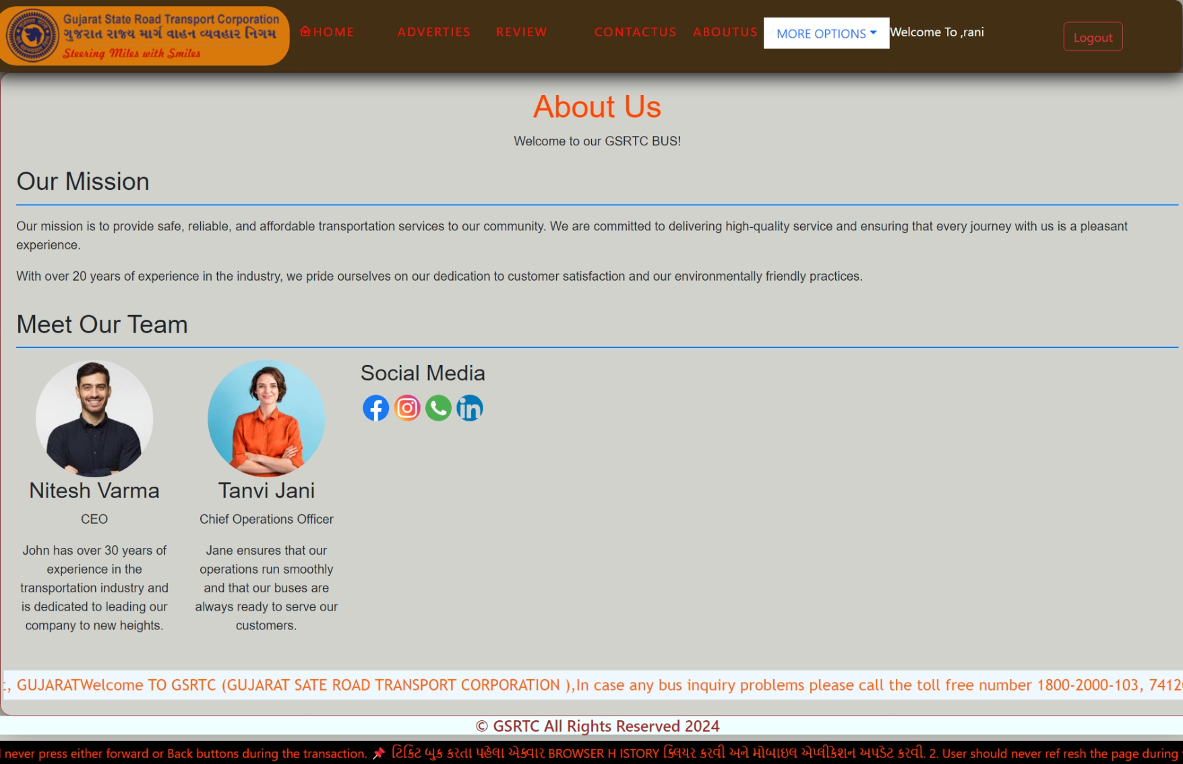
ABOUT US PAGE

Slide 35
aDMIN SIDE INTERFACE

Slide 36
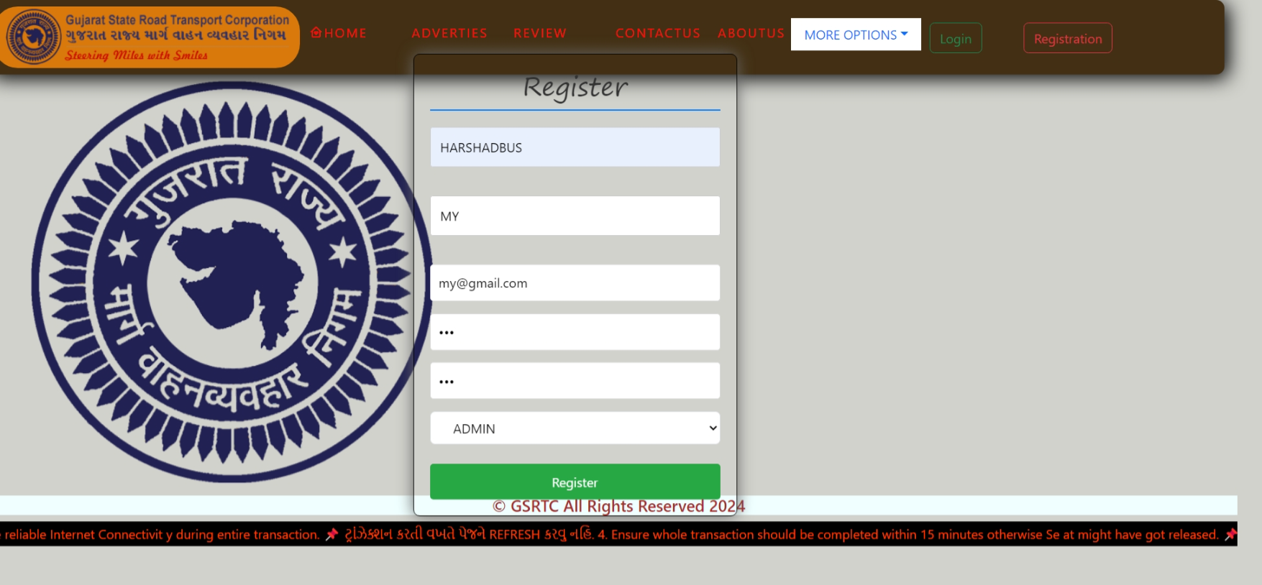
ADMIN REGISTRATION

Slide 37

ADMIN LOGIN

Slide 38
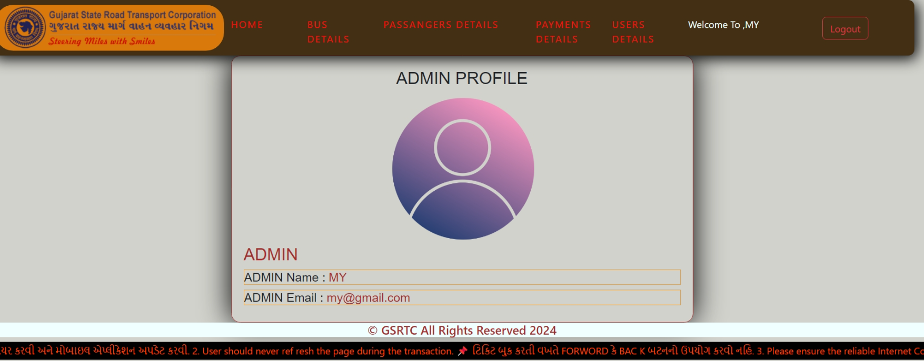
ADMIN PROFILE PAGE

Slide 39
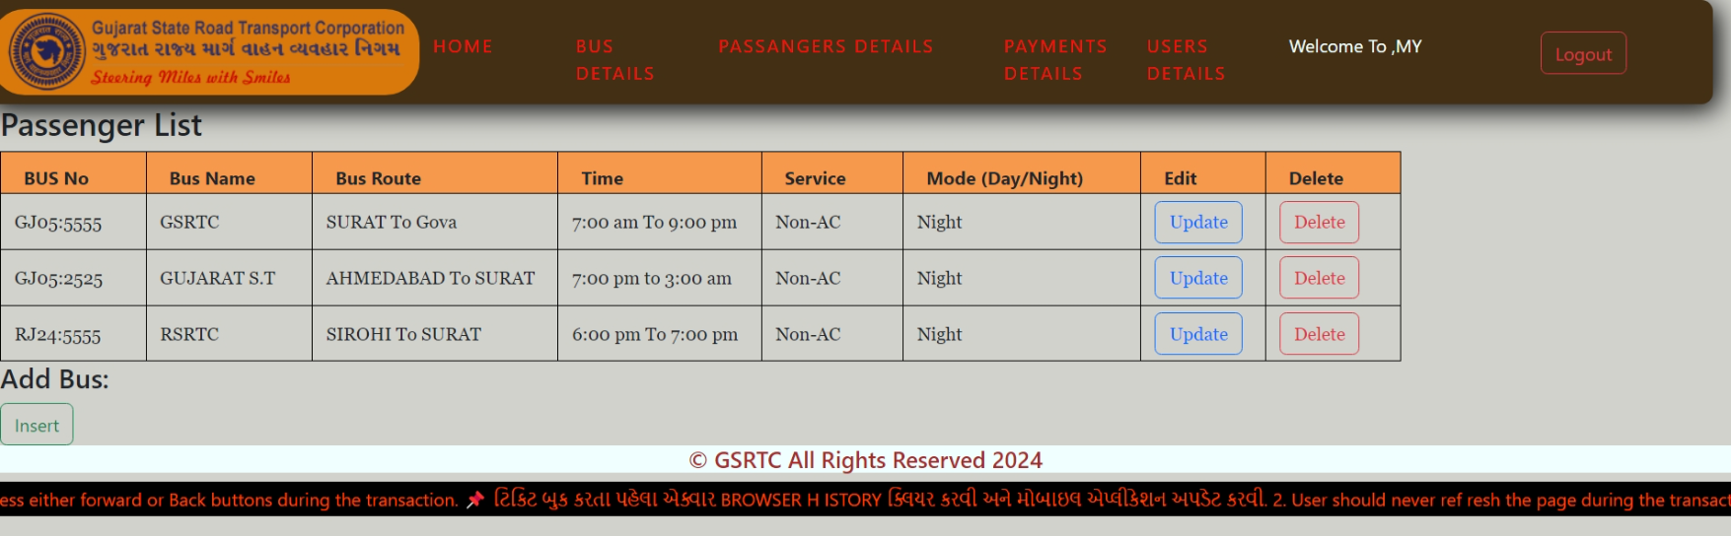
BUS DETAILS PAGE

Slide 40
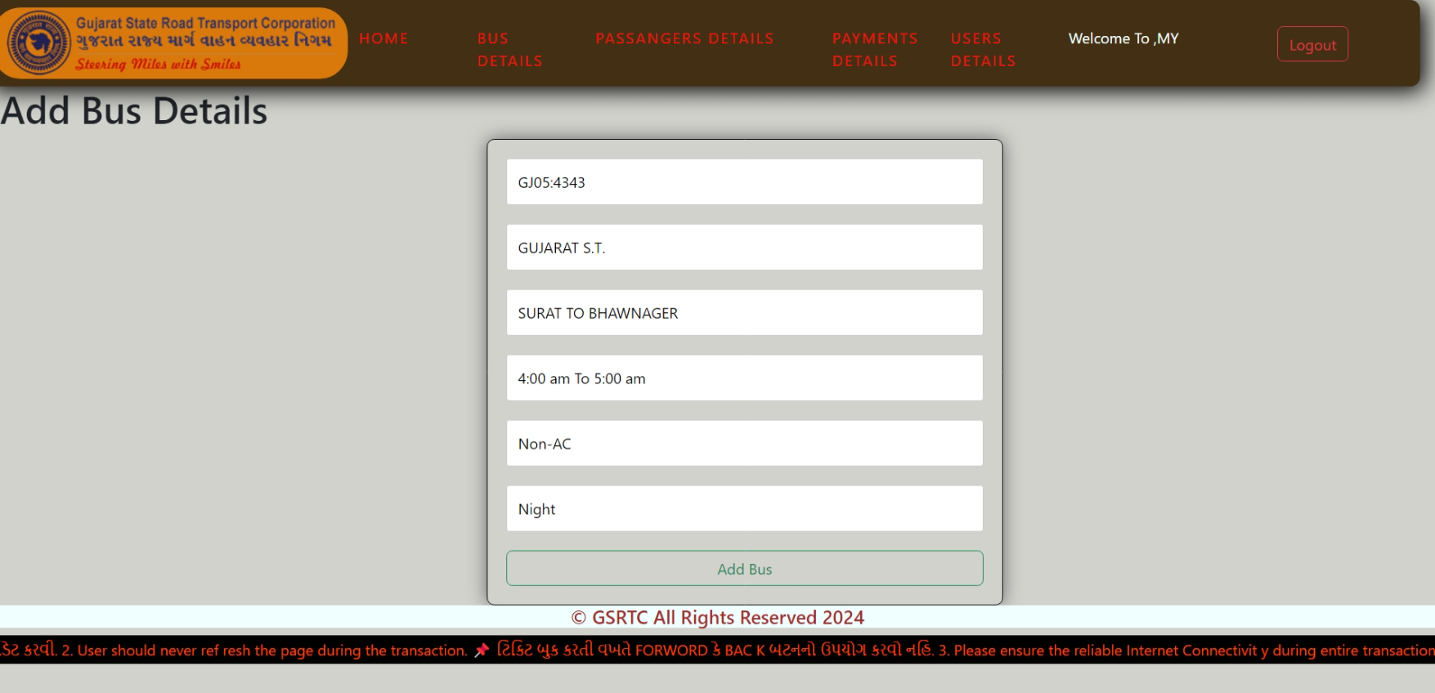
ADD BUS PAGE

Slide 41
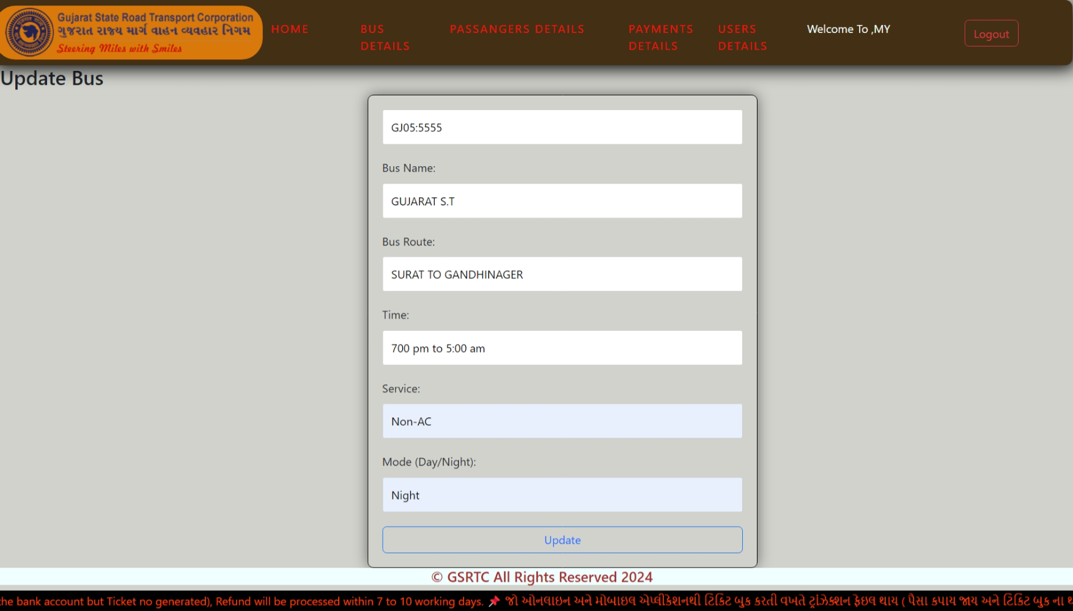
UPDATE BUS PAGE

Slide 42
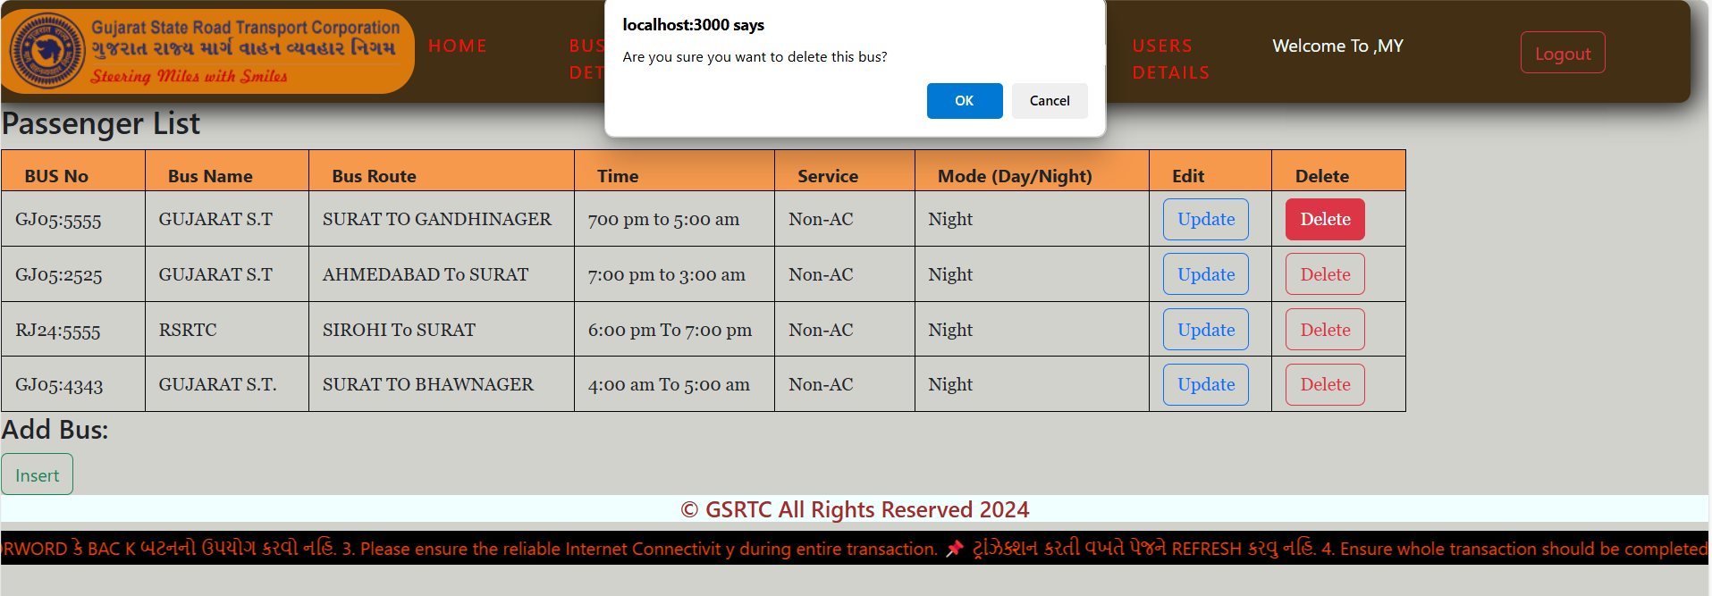
DELETE BUS PAGE

Slide 43
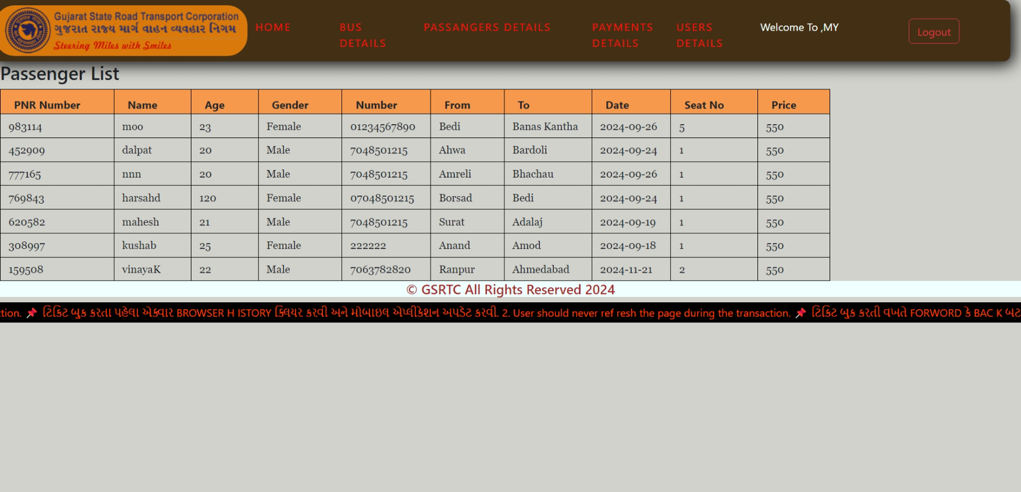
PASSANGER DETAILS PAGE

Slide 44
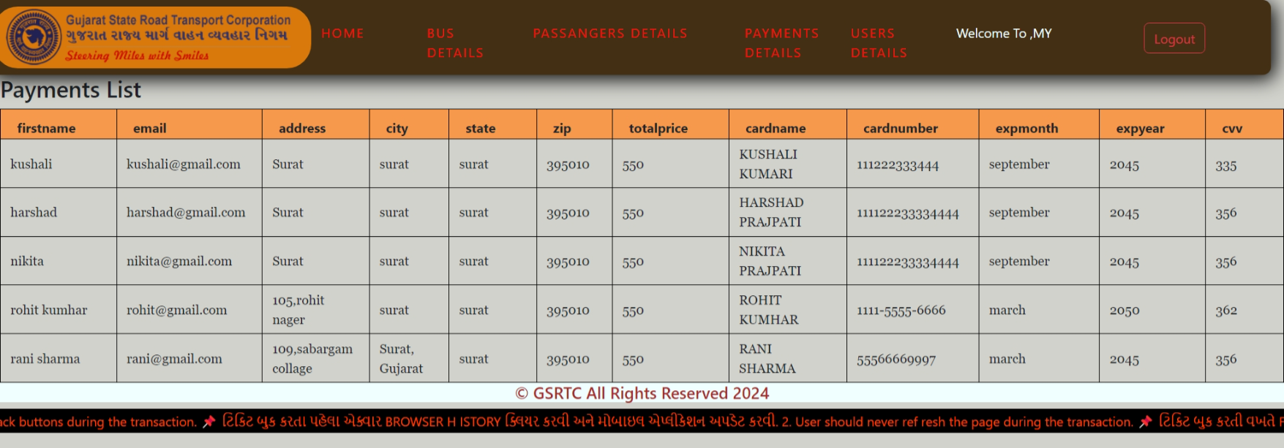
PAYMENT DETAILS PAGE

Slide 45
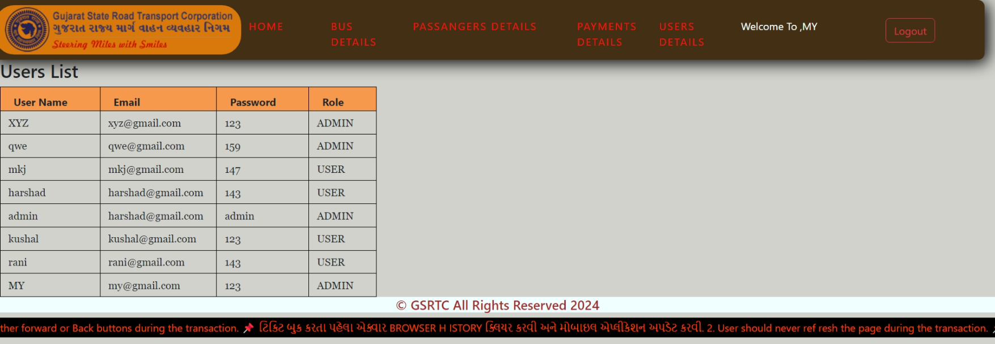
USERS & ADMIN DETAILS PAGE

Slide 46
THANK YOU

